Slide 1
Acoustic Waves
Dr. Eric K. K. Abavare

Slide 2
Acoustics: introduction
Deals with generation, reception and propagation of sounds
Acoustic wave is an oscillation of pressure that travels through a solid, liquid or gas in a wave pattern
It transmits sound by vibrating organs in the ear that produce the sensation of hearing

Slide 3
Definition of Acoustics
The frequency of a sound wave is the number of waves that pass a point each second
Sound waves with higher frequencies have higher pitches than sound waves with lower frequencies
Amplitude is the measure of energy in a sound wave and affects volume
The greater the amplitude of an acoustic wave, the louder the sound.

Slide 4
Process of Hearing
An acoustic wave is what makes humans and other animals able to hear
Human ear perceives the vibrations of an acoustic wave and interprets it as sound
The ear drum starts a chain reaction and sends the vibration through three little bones in the middle ear that amplify sound
Those bones are called the hammer, the anvil and the stirrup.

Slide 5
Hearing process
the vibrations of the sound wave are turned into electrical impulses that the brain can interpret .
The fluid inside the cochlea moves because of the stirrup bone’s pressure, and in turn, moves a hair-cell-lined membrane buried within the fluid
The hair cells move according to the pattern of the acoustic wave, sending signals to nerve cells that carry their interpretation of the wave to the brain.
The brain interprets the acoustic wave as sound and as a result, we hear.
The human brain likes patterns

Slide 6
Sound reception
In the sonic range of frequencies, the microphone, a device using electrical and mechanical components , is used to receiving sound
One simple form is to have a diaphragm as one plate of an electrical condenser
When the diaphragm vibrates under the action of a sound wave, the current in the circuit varies due to the varying capacitance of the condenser

Slide 7
Sound reception
This varying current can then be used to activate a meter or oscilloscope or, after suitable processing, make an audio tape or some such permanent record.

Slide 8
Sound production and recording
Sound recording and reproduction is an electrical or mechanical inscription and re-creation of sound waves, such as spoken voice, singing, instrumental music or sound effects.
The two main classes of sound recording technology are analogue recording and digital recording

Slide 9
Analogue recording
Acoustic analogue recording is achieved by a small microphone diaphragm that can detect changes in atmospheric pressure (acoustic sound waves) and record them as a graphic representation of the sound waves on a medium such as a phonograph
Magnetic tape recording: the sound waves vibrate the microphone diaphragm and are converted into a varying electric current, which is then converted to a varying magnetic field by an electromagnet

Slide 10
Digital Recording
Digital recording and reproduction converts the analogue sound signal picked up by the microphone to a digital form by a process of digitization, allowing it to be stored and transmitted by a wider variety of media.
Digital recording stores audio as a series of binary numbers representing samples of the amplitude of the audio signal at equal time intervals, at a sample rate so fast that the human ear perceives the result as continuous sound

Slide 11
The ear sound recording and reproduction
Human ear is a natural sound receiver. The human voice and the human ear together form a fundamental and natural sound system
The hearing mechanism is a highly sensitive electro-acoustic transducer. The human ear responds to sound waves of a wide range of frequencies waveforms and intensity

Slide 12
Ear sound recording and production
The brain converts these pulses into aural sensations viz perception of sound.
The human ear responds to frequencies in the range 20 to 20,000 hertz .The range of sound intensity over which the ear is sensitive is 1 watt/m² to 10⁻¹² watt/m²
The human ear is more sensitive to variations in frequencies as compared to variations in sound intensities.
The human ear is comparatively more sensitive to sounds of low intensity.

Slide 13
The loudspeaker sound recording and reproduction
A loudspeaker also works on the principle that a magnet exerts a force on a current –carrying wire
A permanent magnet is mounted directly in line with the coil of wire .
As the current alternates at the frequency of the audio signal the coil and attached speaker cone move back and forth at the same frequency, causing alternate compression and rarefaction of all adjacent air, and sound waves are produced.

Slide 14
Sound track pitch
Pitch represents the perceived fundamental frequency of a sound. It is one of the four major auditory attributes of sounds along with loudness, timbre and sound source location
When the actual fundamental frequency can be precisely determined through physical measurement, it may differ from the perceived pitch because of overtones, also known as partials, harmonic or otherwise

Slide 15
Loudness and Intensity
The amount of energy which is transported past a given area of the medium per unit of time is known as the intensity of the sound wave
Depends on Amplitude of vibration of the medium
Intensity is the energy/time/area; and since the energy/time ratio is equivalent to the quantity power, intensity is simply the power/area.

Slide 16
Loudness and intendsity
Loudness depends upon intensity and also upon the sensitiveness of the ear.
L α Log I
where L represents the sensation of loudness and I, the intensity of sound.
Loudness is an attribute of sound that depends primarily on the amplitude of the wave. The larger the amplitude, the louder the sound.

Slide 17
The Bel and decibel
It is a measurement unit used when comparing two sound intensities. Whenever the intensity of sound is increased by a factor of 10, the increase in intensity is said to be 1 bel.
Therefore the dynamic range of audibility of the human ear is 12 bels or 120 decibels. The decibel (dB) is used to measure sound level, but it is also widely used in electronics, signals and communication

Slide 18
decibel
The decibel (dB) is used to measure sound level, but it is also widely used in electronics, signals and communication.
The dB is a logarithmic unit used to describe a ratio. The ratio may be power, sound pressure, voltage or intensity or several other things

Slide 19
For instance, suppose we have two loudspeakers, the first playing a sound with power P₁, and another playing a louder version of the same sound with power P₂, but everything else (how far away, frequency) kept the same.
The difference in decibels between the two is defined to be
10 log (P₂/P₁) dB
where the log is to base 10.

Slide 20
Example calculation
If the second produces twice as much power than the first, the difference in dB is
10 log (P₂/P₁) = 10 log 2 = 3 dB
If the second had 10 times the power of the first, the difference in dB would be
10 log (P₂/P₁) = 10 log 10 = 10 dB.
they can describe very big ratios using numbers of modest size. But note that the decibel describes a ratio (dimsionless quantity)

Slide 21
Intensity levels
Sound intensity level or acoustic intensity level is a logarithmic measure of the sound intensity (measured in W/m²), in comparison to the reference level of 10⁻¹² W/m²
The measure of a ratio of two sound intensities is
where I₁ and I₀ are the intensities
If I₀ is the standard reference sound intensity, where

Slide 22
Threshold of hearing
Sound level measurements in decibels are generally referenced to a standard threshold of hearing at 1000 Hz for the human ear which can be stated in terms of sound intensity or in terms of sound pressure
It is approximately the quietest sound a young human with undamaged hearing can detect at 1,000 Hz
The absolute threshold of hearing (ATH) is the minimum sound level of a pure tone that an average ear with normal hearing can hear with no other sound present. The absolute threshold relates to the sound that can just be heard by the organism.

Slide 23
Loudness quality
It depends on the presence of overtones. The quality of sound enables us to distinguish between two sounds having the same loudness and pitch. Due to the quality of sound, one can recognize his friend from his voice without seeing him.

Slide 24
Acoustic transducers
An acoustic transducer is an electrical device that coverts sound wave vibrations into mechanical or electrical energy. They have various practical applications, including sound recording and sound playback. A specialized model, called an ultrasonic acoustic transducer, can be used to measure distance to, as well as the mass of, an object.

Slide 25
Ultrasonic
Sound waves of high frequency are called ultrasonics. The frequency of ultrasonic is higher than 20,000 hertz. These frequencies are beyond the audible limit. Their wavelengths are small. The sound waves of frequency lower than the audible limit are called Infra-Sonics.

Slide 26
Production of ultrasonic waves
Galton whistle works on the principle of organ pipe. It consists of a closed end air column A whose length can be adjusted with the help of a moveable piston.

Slide 27
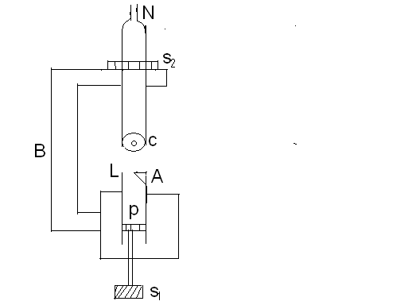
If L is the length of the air column in A, X the end correction, then the wavelength λ = 4(l+x)

Slide 28
Applications of ultrasonic waves
Depth of sea
Heating effects
Mechanical effects
Cracks in metals

Slide 29
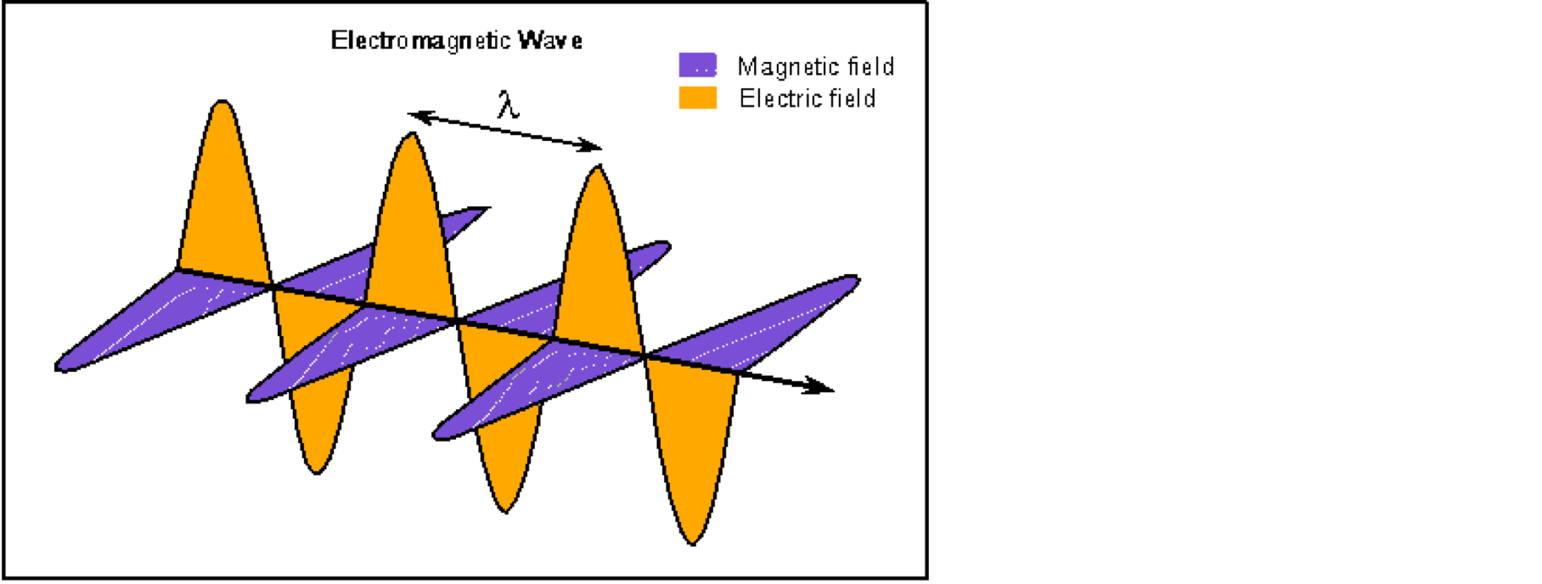
ELECTROMAGNETIC WAVES
phenomenon that takes the form of self-propagating waves in a vacuum or in matter.
It consists of electric and magnetic field components, which oscillate in phase perpendicular to each other and perpendicular to the direction of energy

Slide 30
EM waves
Gamma and X-radiation
Ultra violet radiation
Visible radiation
400–440 nm Violet
440–480 nm Blue
480–530 nm Green
530–590 nm Yellow
590–630 nm Orange
630–700 nm Red
Infrared radiation

Slide 31
EM spectrum

